Slide 1
Technical English for Computer Science
Week 2
Dr. Nur Banu OĞUR

Slide 2

Reading
Use the information in the reading passage and the diagram to help you match the terms
below with the appropriate explanation or definition.

Slide 3
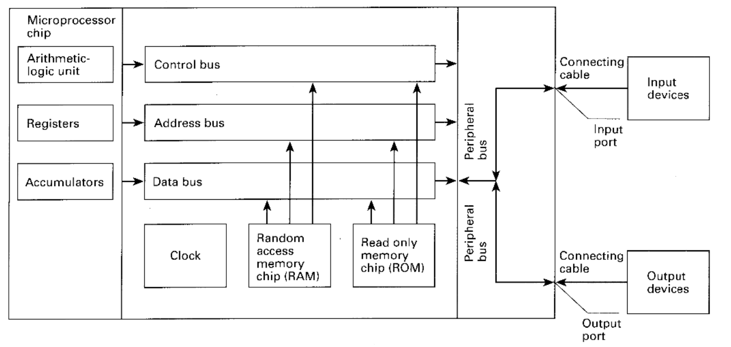

Slide 4

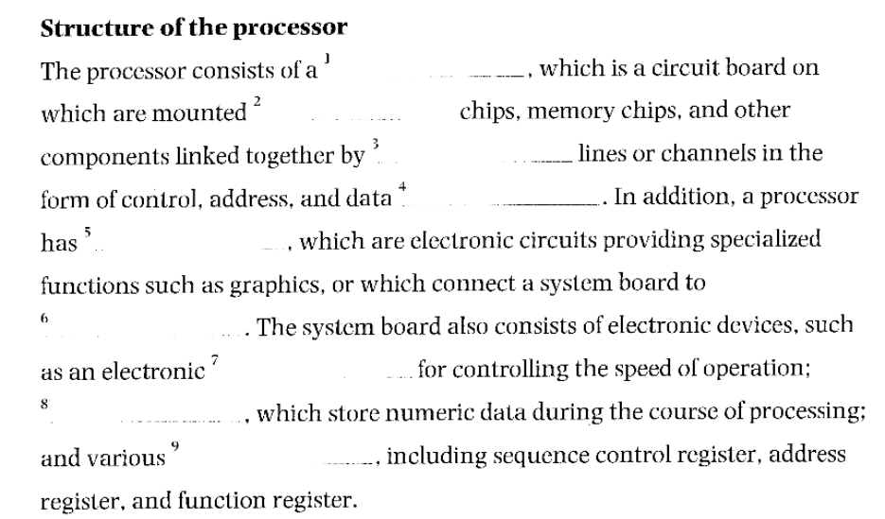
The Processor

Slide 5
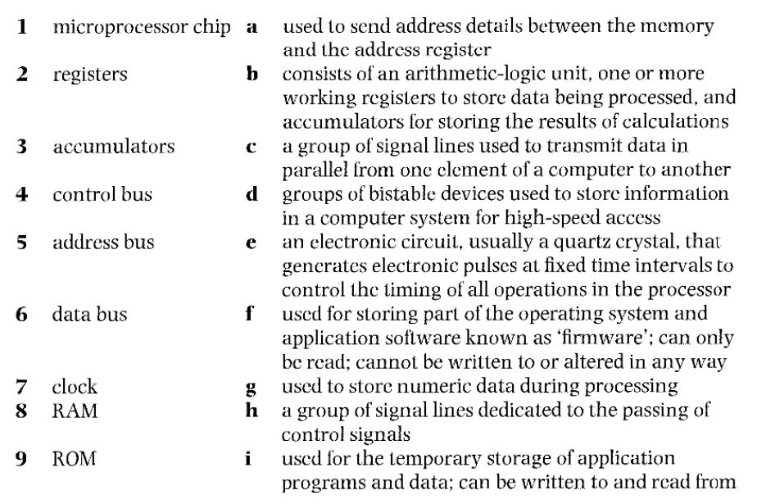

Slide 6
Portable Computers

Slide 7
How small can computers get?

Slide 8

Before reading text, match these words with their definitions

Slide 9
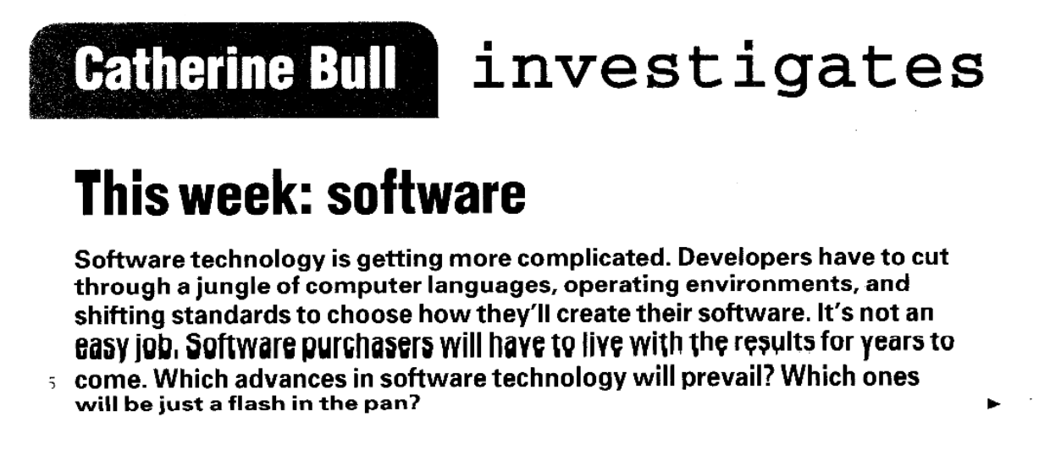

Slide 10
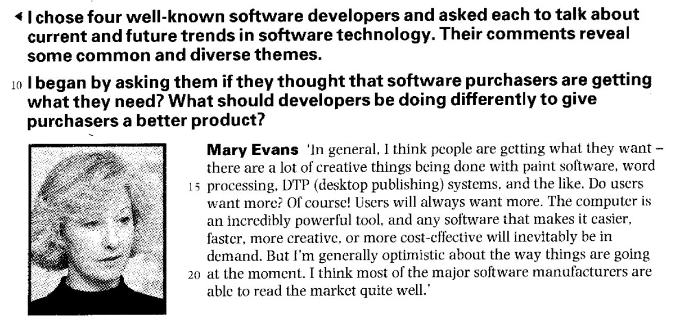

Slide 11


Slide 12
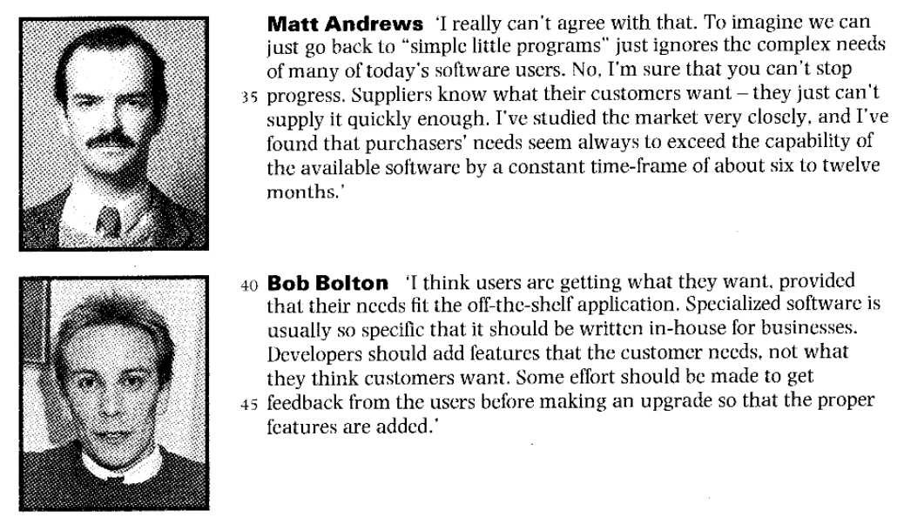

Slide 13
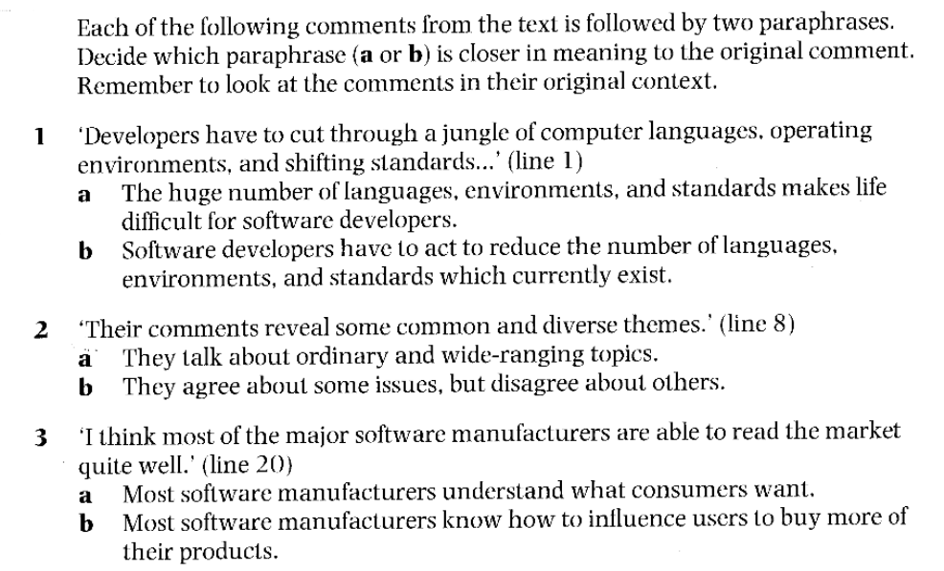

Slide 14
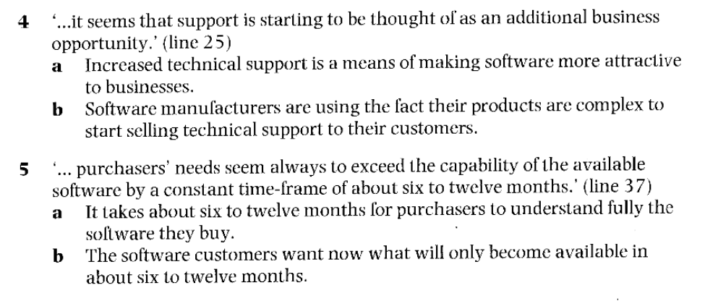

Slide 15
Which of the four speakers do you most agree with? Why?

Slide 16
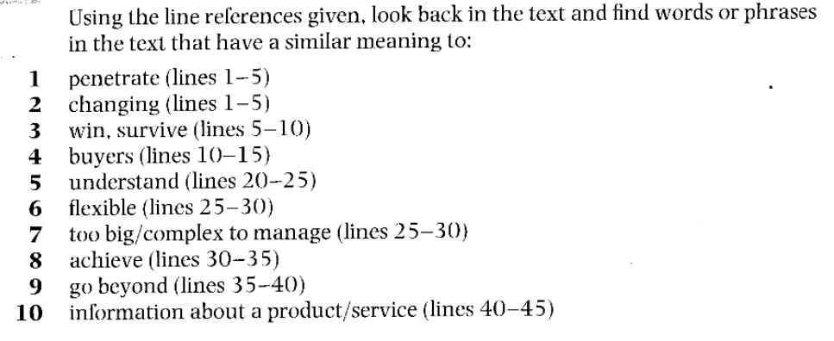

Slide 17
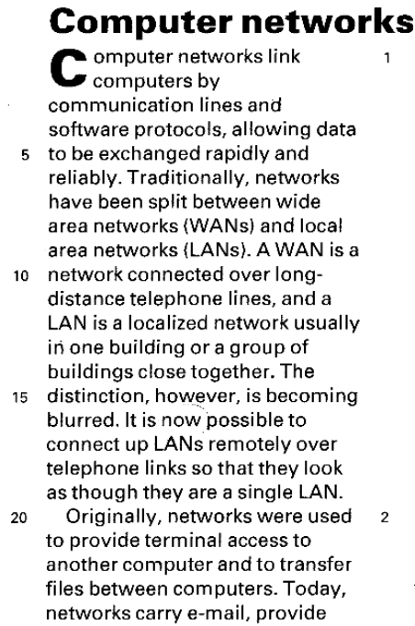
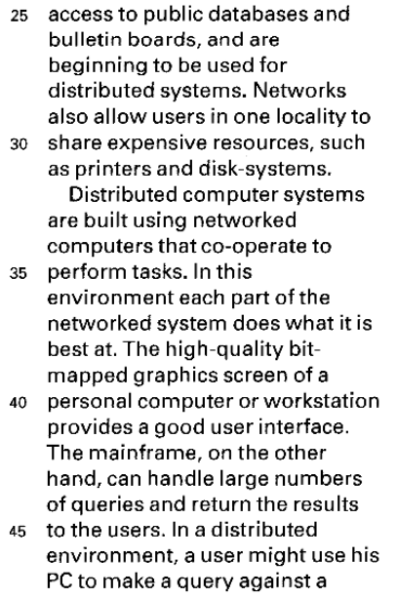
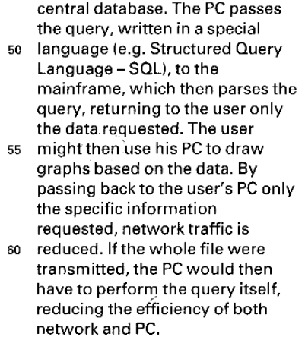

Slide 18
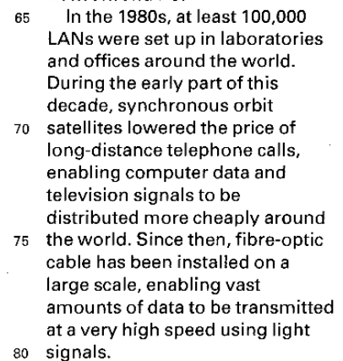
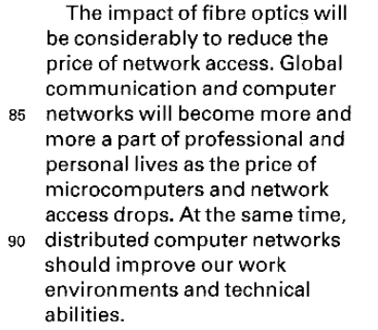

Slide 19
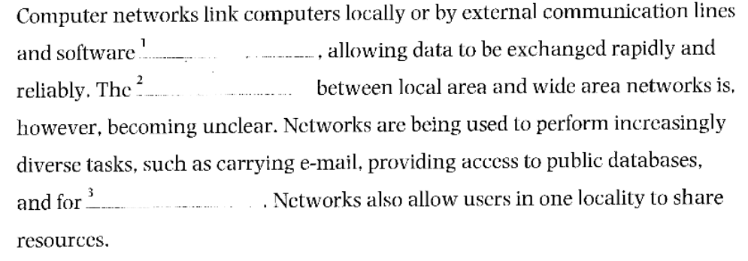

Read this summary of the text and fill the gaps using the list of words below.

Slide 20
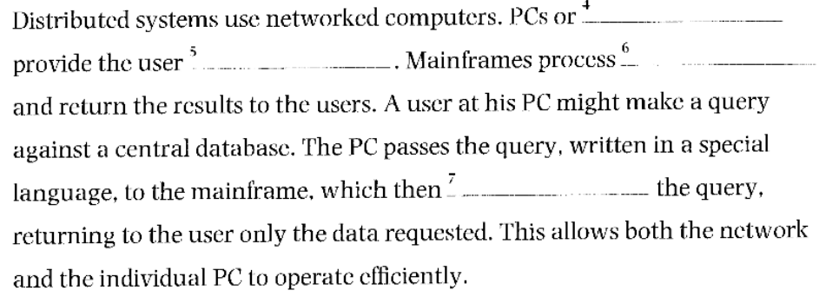

Slide 21
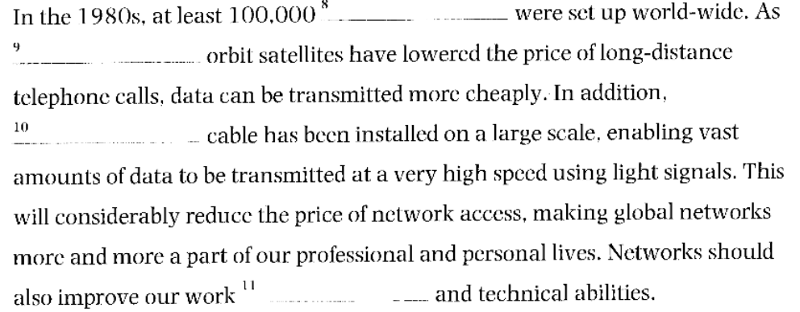

Slide 22


Slide 23


